Slide 1
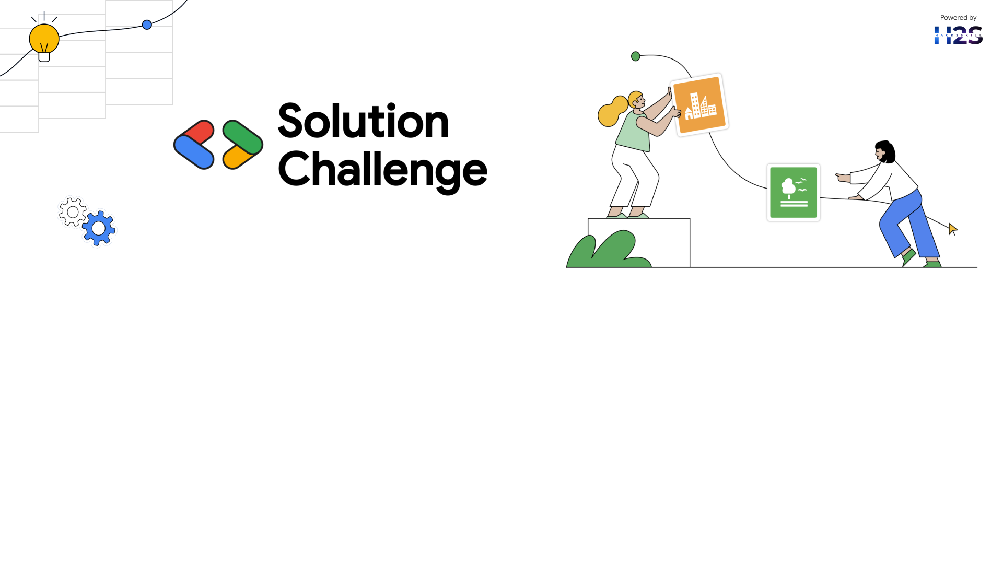
Team Details
Team name: DATA MAVERICKS
Team leader name: SREEJITH S
Problem Statement: Tackling Climate Change Through Innovation and Collaboration

Slide 2

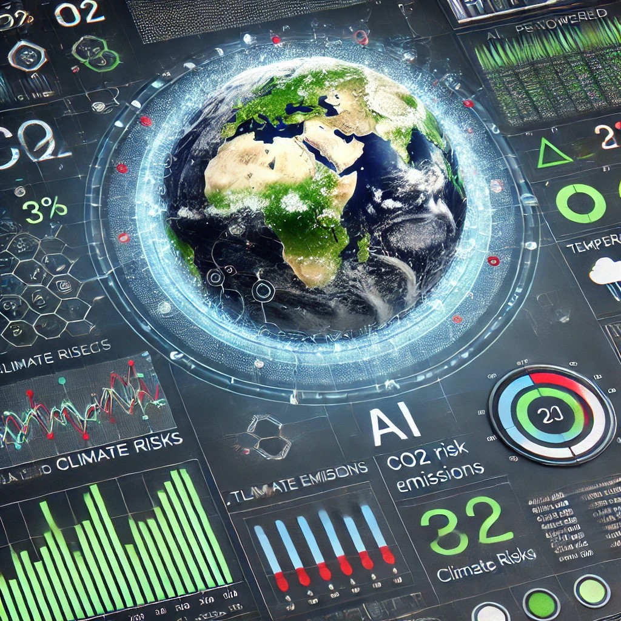
Title: AI-Powered Climate Risk Predictor
Content:
Our solution uses Machine Learning and AI to predict CO₂ emissions and climate risks, helping policymakers and industries make data-driven decisions.
Key Features:
Real-time CO₂ & climate risk prediction using ML models (Random Forest, XG Boost, LSTM).
AI-powered climate mitigation strategies via Google Gemini API.
Geospatial visualization (Folium maps) to highlight high-risk climate zones.
User-friendly web app for interactive climate analysis & dataset uploads.
This system enables proactive climate action and supports sustainability efforts worldwide.
FIGURE 1. Visually represents CO₂ emissions, climate risks, and AI-driven insights

Slide 3
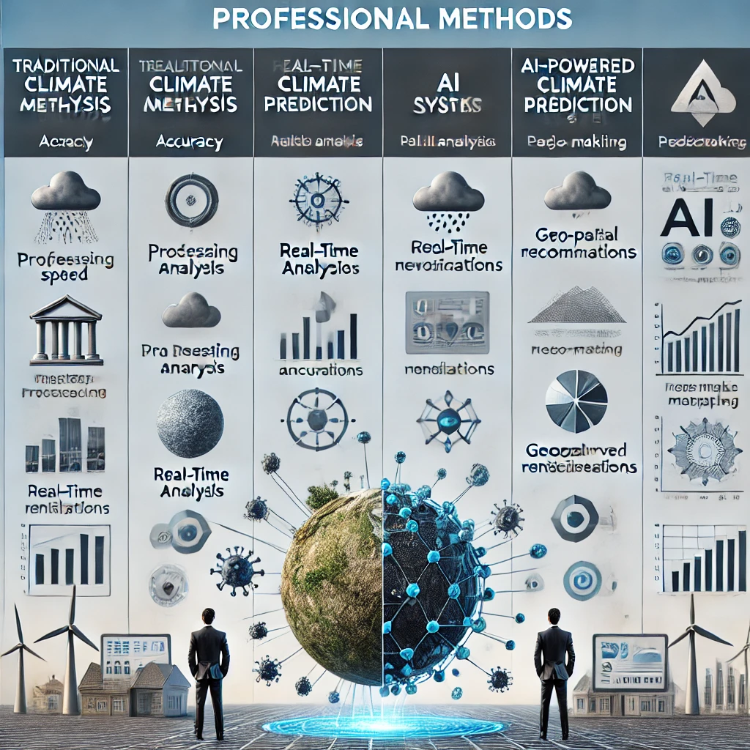
How Different is it from Existing Ideas?
Unlike traditional climate analysis tools, our solution:
Combines AI + ML + GIS for real-time climate predictions.
Uses Google Gemini AI to generate custom climate mitigation strategies.
Geospatial heatmaps visualize high-risk zones, making data actionable.
How Will it Solve the Problem?
Current Challenges:
Climate risks are hard to predict with static models.
Lack of real-time AI-driven insights for policymakers.
No interactive geospatial tool for climate data analysis.
Our Solution:
Predicts CO₂ emissions & climate risks accurately using ML models.
Generates AI-driven recommendations for governments & industries.
Visualizes risk areas on a global map for quick decision-making.
Deployable & scalable, making it accessible for global use.
Unique Selling Proposition (USP):
“AI-Driven Climate Intelligence for a Sustainable Future”
Predict, Analyse, & Act – A one-stop AI-powered climate monitoring solution.
Real-time Insights – Instant risk assessment for effective policy changes.
Easy Deployment – Web-based solution for any organization to implement.
AI-Powered Decision Making – Helps industries & governments take data-backed actions.
FIGURE 2. Comparison Chart – Show how your solution is better than traditional models.

Slide 4
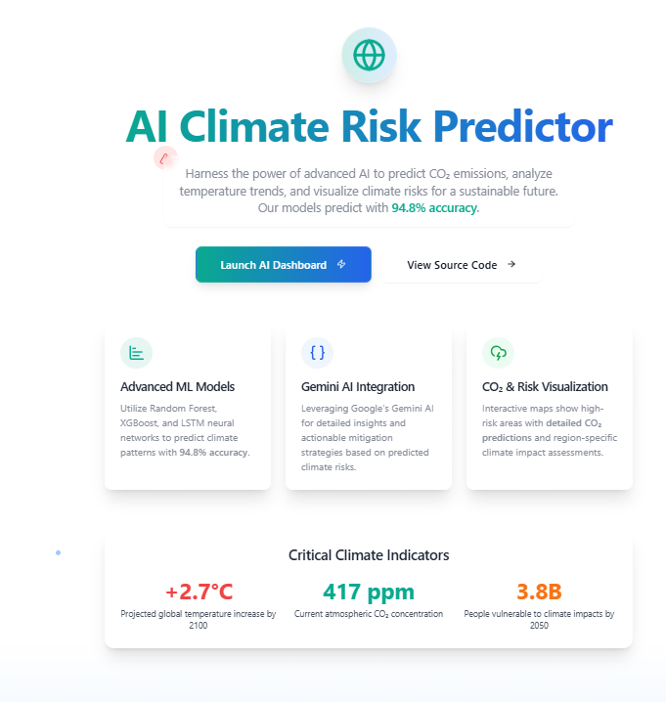
1. AI-Powered Climate Prediction
Uses Machine Learning (Random Forest, XG Boost, LSTM) to predict CO₂ emissions, temperature changes, and pollution levels.
2. Google Gemini AI for Climate Insights
Generates AI-driven climate mitigation strategies based on real-time data.
3. Real-Time Geospatial Visualization
Interactive Folium Maps show high-risk climate zones.
Helps policymakers & industries make data-driven decisions.
4. User-Friendly Web Application
Allows users to upload climate datasets and get predictions Instantly.
Cloud-based & accessible from anywhere.
5. Explainable AI (SHAP Analysis)
Provides transparent insights on how ML models make predictions.
Helps build trust & reliability in AI-powered climate forecasting.
6. Scalable & Deployable on IDX
Ready for real-world implementation with cloud deployment.
Can be scaled for global use across organizations.
FIGURE 3. A mockup of the web application interface

Slide 5
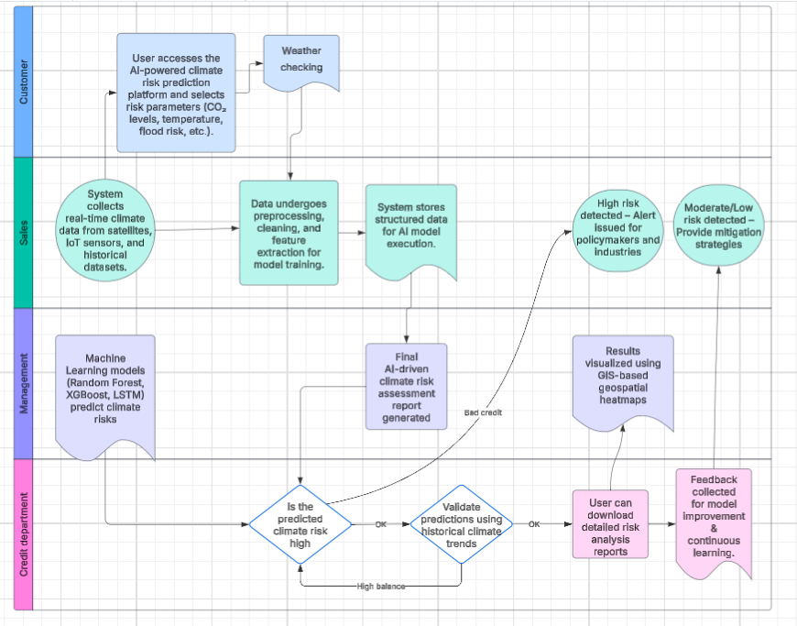
Process flow diagram or Use-case diagram:
Understanding the Process Flow:
A Process Flow Diagram (PFD) shows how data moves through your AI-powered climate risk prediction system.
The key steps include:
Data Collection – Collect climate data from databases, IoT sensors, satellites.
Data Preprocessing – Clean, normalize, and prepare data for ML models.
Machine Learning Predictions – Use Random Forest, XG Boost, LSTM to forecast CO₂ levels & climate risks.
Google Gemini AI Insights – Generate mitigation strategies using AI-driven recommendations.
Geospatial Visualization – Display climate risks using Folium & GIS mapping.
User Interaction & Decision Making – Policymakers, researchers, and industries use insights for climate action.
FIGURE 4. Process Flow Diagram

Slide 6
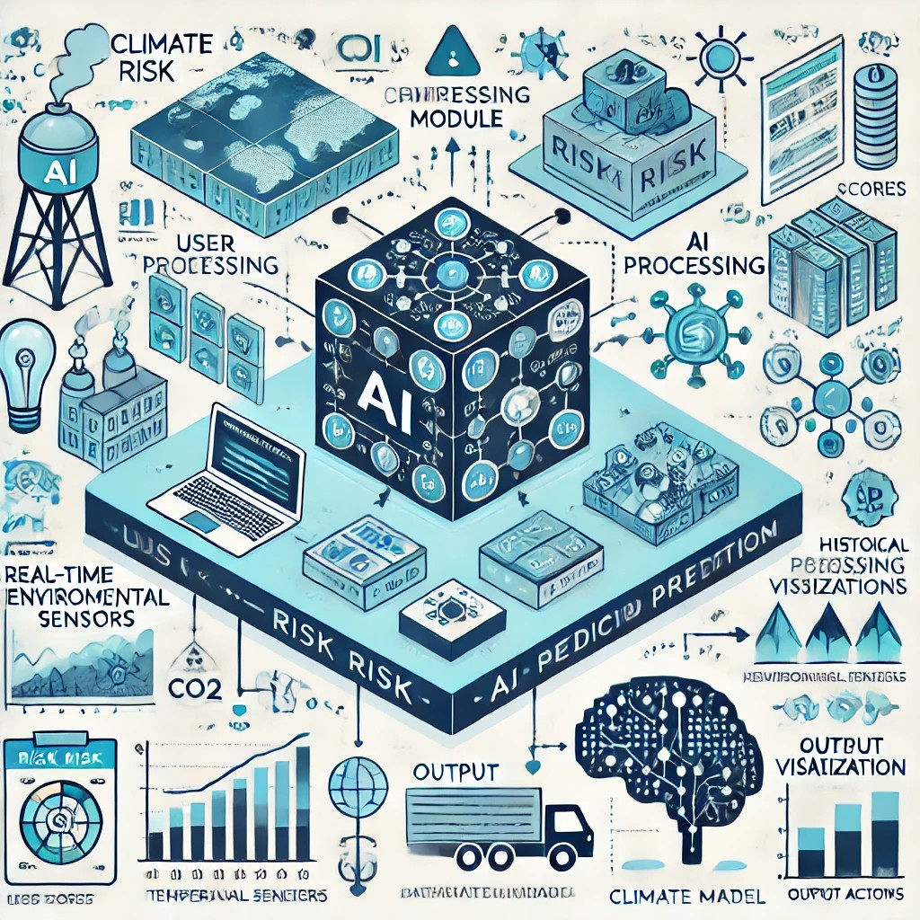
Overview:
The AI Climate Risk Predictor uses machine learning to analyze CO₂ emissions and predict climate-related risks. The wireframe will showcase the user flow from input collection to risk assessment visualization.
Wireframe Sections:
1️⃣ User Input Panel: Users enter parameters like industrial emissions, temperature, humidity, and location. 2️⃣ AI Processing Module: The model processes the data, applies machine learning, and predicts future climate risks. 3️⃣ Output Visualization: Risk scores, CO₂ trends, and mitigation recommendations are displayed as graphs or heatmaps. 4️⃣ User Actions: Users can generate reports, receive alerts, or explore mitigation strategies.
FIGURE 5. block diagram illustrating the AI-powered Climate Risk Prediction System

Slide 7
Overview:
The architecture of the AI Climate Risk Predictor follows a structured workflow that integrates data collection, preprocessing, machine learning model deployment, and visualization to predict CO₂ emissions and climate risks. Below is a breakdown of each stage in the architecture:
1. Data Collection Layer
Data Sources:
Climate databases (e.g., NOAA, NASA, IPCC)
Government & environmental datasets
IoT sensors (air quality, temperature, humidity)
Satellite imagery for emissions detection
Data Ingestion:
APIs, web scraping, and real-time data streams collect structured and unstructured data.
2. Data Processing & Storage
Data Preprocessing:
Handling missing values, normalizing data, and feature selection.
Converting categorical data into numerical values.
Data Storage:
Cloud Database: Google Big Query / AWS S3 for scalable storage.
Local Storage: CSV, JSON, or databases like PostgreSQL for structured storage.

Slide 8
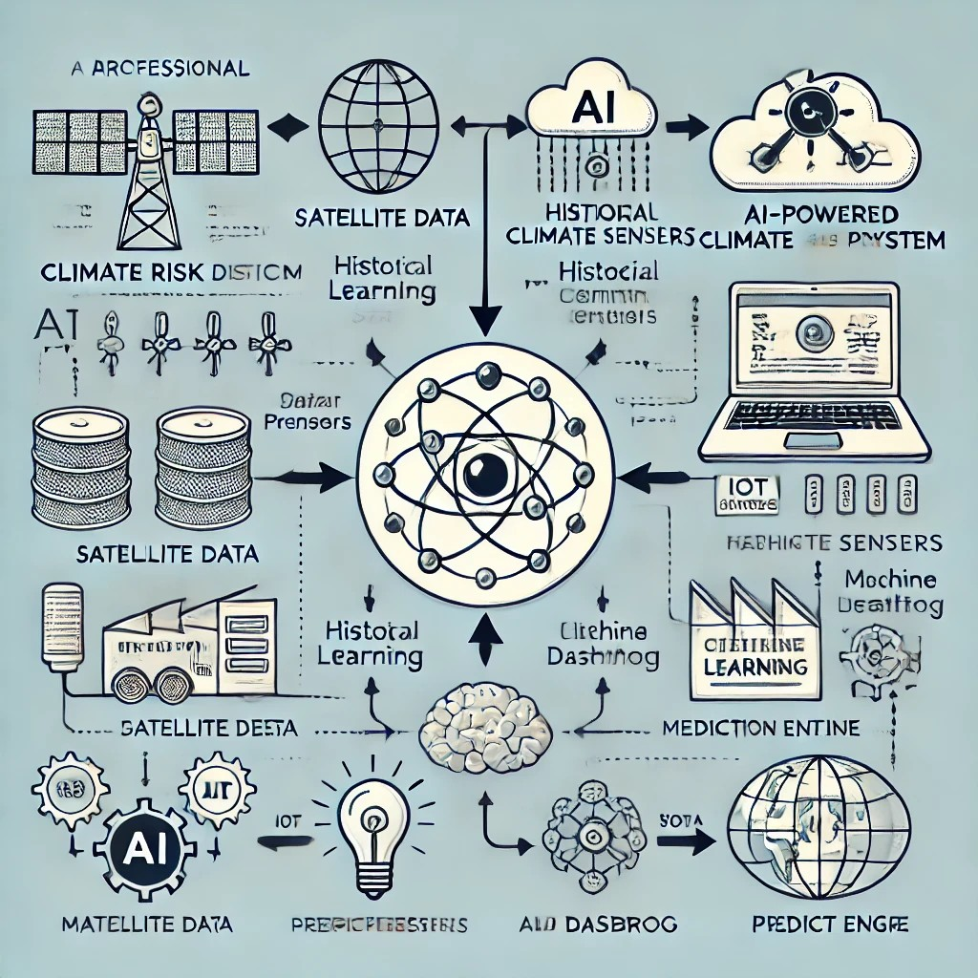
3. Machine Learning Model
Feature Engineering:
Extracting meaningful features such as CO₂ levels, temperature variations, deforestation rates, and economic impact.
Model Selection:
Supervised Learning Models: Decision Trees, Random Forest, XG Boost
Deep Learning Models: LSTMs for time-series forecasting
NLP Models: To analyse climate policies and reports
Training & Validation:
Splitting data into training and testing sets.
Using Google Vertex AI or AWS Sage Maker for scalable model training.
4. Future Enhancements:
Integrating Google Gemini APIs for advanced text-based climate analysis.
IDX-based development for seamless deployment and monitoring.
Enhanced IoT Integration to capture real-time emissions data from industrial zones.
FIGURE 6. architecture diagram for your AI-powered Climate Risk Prediction System

Slide 9
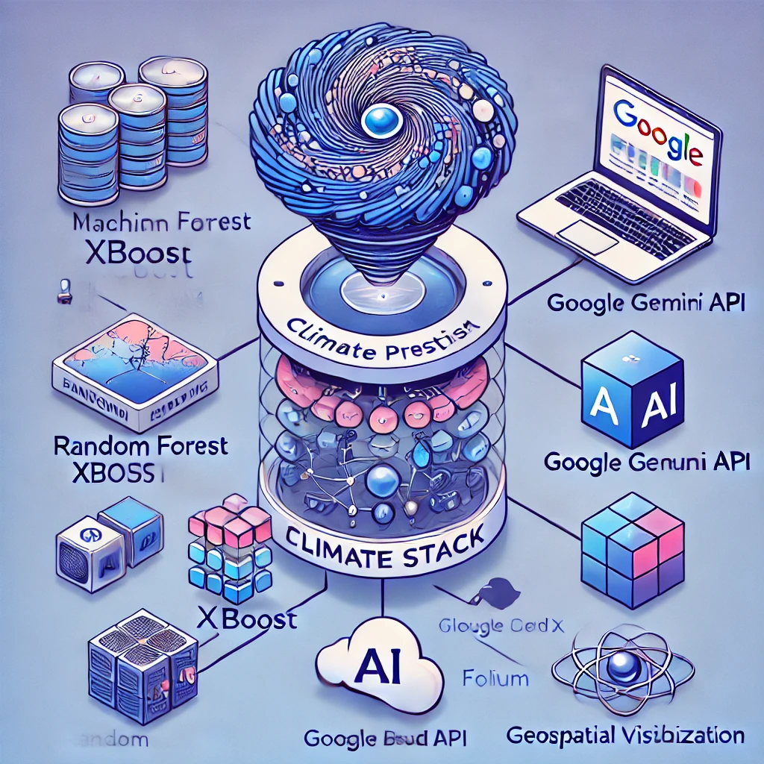
Technologies to be used in the solution:
1️⃣ Machine Learning & AI Models
Random Forest, XG Boost, LSTM – For CO₂ emissions and climate risk prediction.
SHAP (Explainable AI) – Provides transparency in AI decision-making.
2️⃣ Google Gemini API Integration
Gemini AI generates real-time climate mitigation strategies.
Enhances decision-making for policymakers & industries.
3️⃣ Cloud Deployment & Web Hosting
Google Cloud (IDX Platform) – Optimized for scalability & deployment.
Lovable . dev – AI-powered low-code deployment for rapid hosting.
4️⃣ Geospatial Visualization
Folium (Python) + GIS – Interactive risk maps for global climate insights.
5️⃣ Web Application Frameworks
Fast API / Flask (Python) – Backend for data processing & AI execution.
React.js / Lovable . dev UI – Interactive front-end dashboard.
FIGURE 7. Tech Stack Diagram – Showing ML models, APIs, and cloud integration.

Slide 10
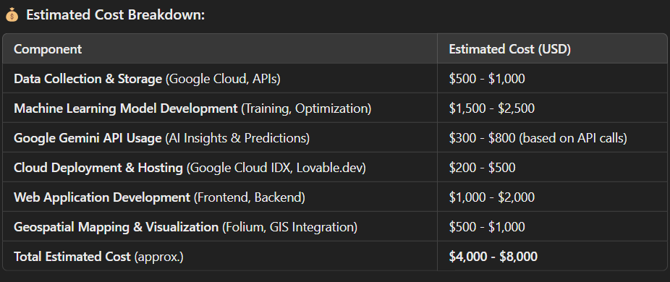
Estimated implementation cost (optional)

Slide 11
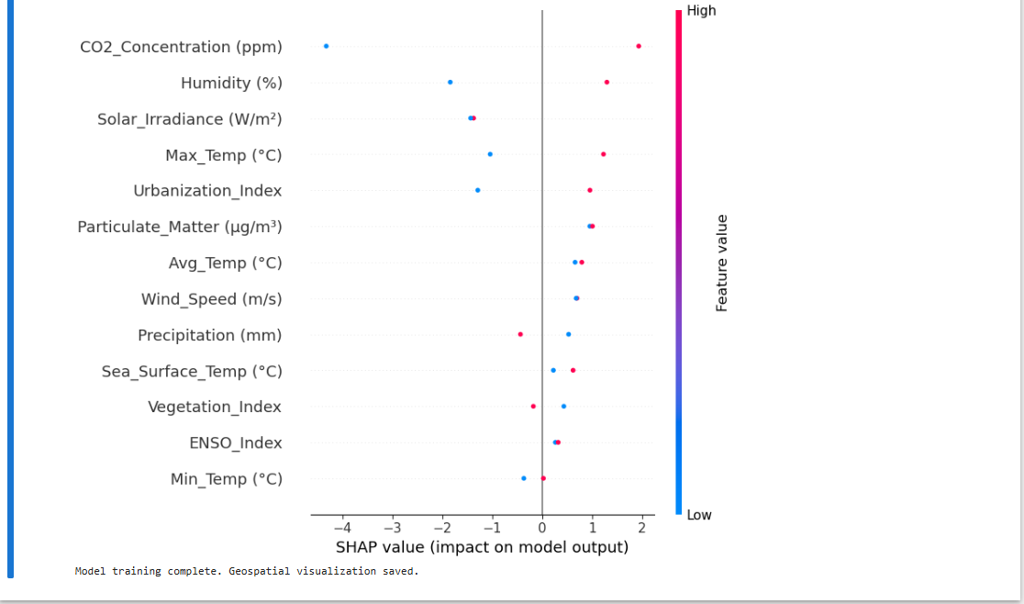
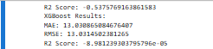
The AI-Powered Climate Risk Predictor MVP is a functional prototype that demonstrates the core capabilities of the solution. It provides:
Real-time CO₂ emission and climate risk predictions using ML models (Random Forest, XG Boost, LSTM).
Google Gemini AI-generated mitigation strategies for sustainability and climate action.
Geospatial visualization (Folium maps) to highlight high-risk climate zones.
User-friendly web application for uploading datasets, running AI models, and getting insights.
Cloud deployment compatibility (Google Cloud IDX, Lovable . dev) for scalability.
Why is the MVP Important?
Proves feasibility – Demonstrates that AI can accurately predict climate risks.
Enables early testing – Users can interact with the system and provide feedback.
Supports further development – The MVP serves as a foundation for advanced features and real-world deployment.
📌 Figure 8. SHAP Explainability Map
📌 Figure 9. AI Model Prediction Results

Slide 12
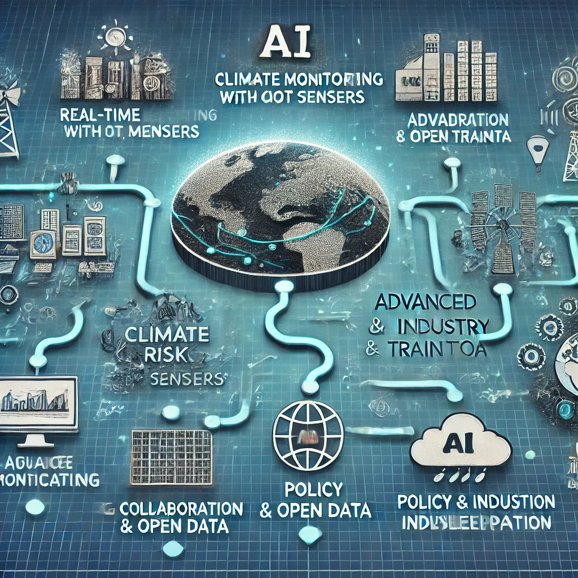
Future Development & Enhancements
Real-Time Climate Monitoring
Integration with IoT sensors & satellite data for live climate tracking.
2. Advanced AI Model Training
Incorporating Deep Learning (CNNs, Transformers) for more accurate climate forecasts.
3. Global Collaboration & Open Data
Creating a public climate data platform where researchers & policymakers can access and contribute to climate insights.
4. Policy & Industry Integration
Generating AI-driven reports for governments, climate organizations, and industries to assist in sustainable decision-making.
5. Mobile Application Development
A mobile version for real-time CO₂ tracking, alerts, and climate recommendations.
FIGURE 10. A roadmap diagram showing the future development stages.

Slide 13
Provide links to your:
GitHub Public Repository:
Demo Video Link (3 Minutes):
MVP Link:

Slide 14


